Slide 1

Talend ESB
Module Code : ESB04
By : Muhammad Faris Ashim

Slide 2
Agenda
Define enterprise integration patterns (EIP)
Name four common EIPs
Use EIPs in a mediation route
Use more-advanced EIPs
4

Slide 3


Talend ESB Basics
Enterprise Integration Patterns

Slide 4
Enterprise integration patterns
Enterprise Integration Patterns is a book by Gregor Hohpe and Bobby Woolf. It describes 65 design patterns that can be used by enterprise application integration and message-oriented middleware in the form of a pattern language.
This book is considered the most comprehensive work on application integration. References : https://www.enterpriseintegrationpatterns.com/patterns/messaging/index.html

Slide 5
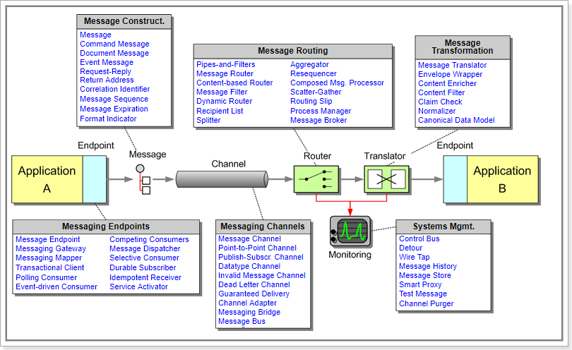
Enterprise integration patterns, continued

Slide 6
Enterprise integration patterns, continued
Each pattern represents an application integration unit action
EIPs are implemented as Camel processors.
They can be found in the palette of the Studio
Reading the Enterprise Integration Patterns book is strongly recommended as a routing design prerequisite

Slide 7

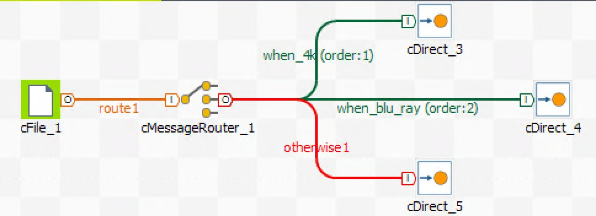
cMessageRouter
This EIP helps you route a message to one of several destinations based on a condition

Slide 8
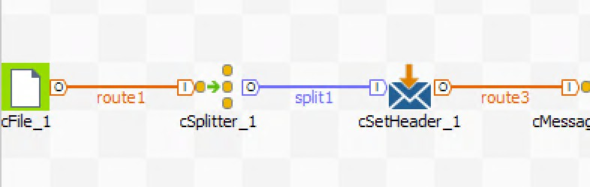
cSplitter
This EIP splits an input message into several messages based on a defined rule. In this training, you will split an XML message into smaller chunks according to an Xpath query.

Slide 9
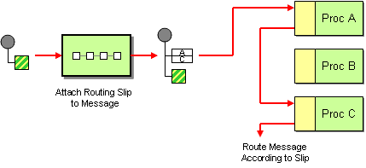
cRoutingSlip
This EIP reroutes a message through a defined sequence of routes. The sequence can be variable for each message. In the corresponding lab for this EIP, the sequence is defined after an analysis of the message content.

Slide 10
cMulticast
This EIP sends one message in parallel to many destinations

Slide 11
Lab overview
In these labs, you will use EIPs to:
Reroute messages based on conditions, thanks to cMessageRouter
Split a message into several messages based on an Xpath query with cSplitter
Route a message to a sequence of processing routes with cRoutingSlip
Route a message to multiple destinations with cMulticast

Slide 12
Talend ESB Basics
Enterprise Integration Patterns (Advanced)

Slide 13
cWireTap
This EIP intercepts messages on a route without disrupting the global process. It is used mostly to capture and log messages.

Slide 14
cLoadBalancer
This EIP can implement a distribution strategy to deliver message to several routes. It is used to balance messages between different routes or platforms.

Slide 15
cThrottler
This EIP makes sure a specific endpoint does not get overloaded, or that you do not exceed an agreed SLA with an external service by limiting the number of messages to be processed in a route in a particular time period.
All exceeding messages are delayed and enqueued for future processing.

Slide 16
Lab overview
In these labs, you will use EIPs to:
Intercept a message and reroute it out of the main route without disrupting it
Load balance the distribution of messages between two routes
Regulate the number of files processed by a route

Slide 17
Thank You

